Slide 1
automating machine learning using devops
By: Sanidhya Sinha
Tutor: Mr. Vimal Daga Sir

Slide 2
CONTENTS
01
Intorduction
01
02 - 06
About Hyper Parameters
07
Problem Statement
08 - 11
Process of Automation
12
Architecture of Pipeline
14 - 26
Process of Automation
27
Conclusions

Slide 3

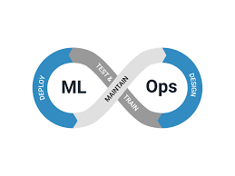
Introduction
01
In this project I'm going to automate the Machine Learning (via Deep Learning) program using DevOps with tools like Docker , Jekins , Redhat and Git/Github.

Slide 4
About HyperParameters

Slide 5
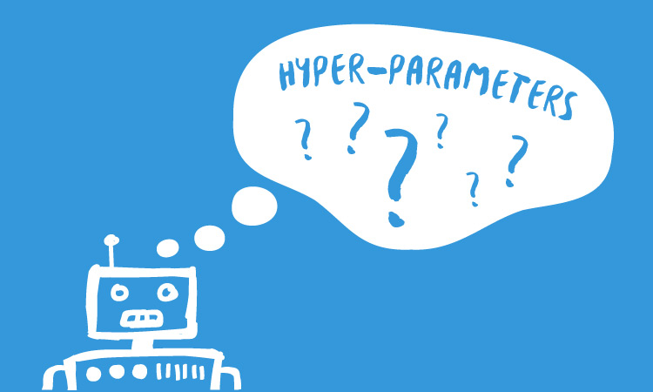
What is Hyper Parameter ?
02
In machine learning, a hyperparameter is a parameter whose value is set before the learning process begins. By contrast, the values of other parameters are derived via training.
These values are given by the developer before building the model .

Slide 6

Hyper Parameter Importance
03
In DL/ML , model performance depends heavily on the hyperparameter values selected.
The goal of hyperparameter is to search across various hyperparameter configurations to find a configuration that results in the best performance.
It works on hit and trial method by the developer.
Hyperparameters are used to determine the structure of the model in use.

Slide 7
Hyper Parameter Importance cont.
04
A hyperparameter can change the outcome of a model for good with regards to the time taken to train it.
Having hyperparameters is half part of the solution, the second part is knowing what kind of hyperparameters suits the need.

Slide 8
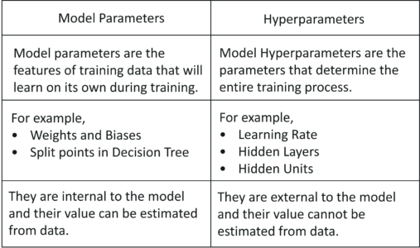
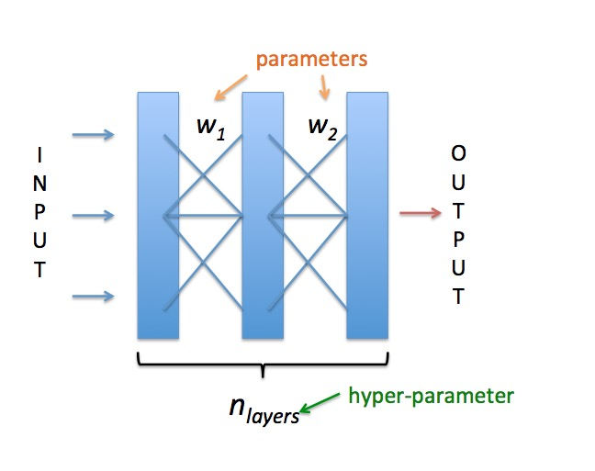
Difference
05

Slide 9
Problems Faced by Hyper Parameter
06
As we don't know the correct values because of which we have to hit and try different combinations for max accuracy.
More hit and try means more power , more time , more cost .
Time of Developers also get wasted.

Slide 10
Problem Statement
07
We have to create a pipeline where we build any CNN model , and as we deploy , it will check the accuracy of the model and if it is less than the accuracy which the devloper is desired of then it will get tuned and the hyper parameters will change autoomatically inorder to get the accuracy above the desired
The work I done in Project :
Here I tried to just build a basic model , where few hyperparameters are changing. But it can be extended and can build a lot much effective code where almost all the hyperparameters are decided by the tweaker.py and also backpropogation can be used if at any level the accuracy decreases. Then we can mail the complete information or can display in a seperate website.

Slide 11
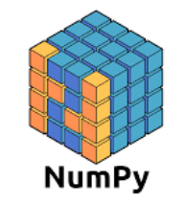










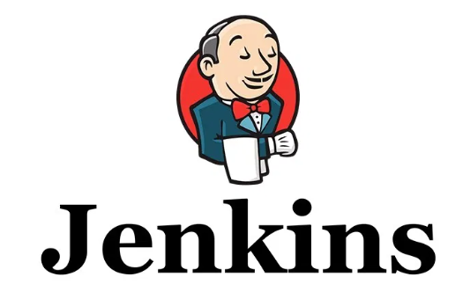
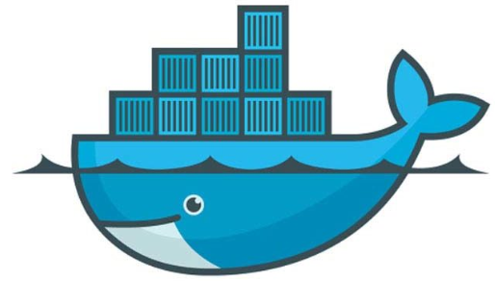

Software Used
08
smtplib

Slide 12
Why Docker?
09
Docker is tool which works on the concept of containerization.
It launches the Operating System based on this concept because of which OS gets launched in 1-2 seconds.
Here we will get the RAM and storage which will get utilized very effectively.
If Failure also occurs in the OS then it can launch new OS instantly
We use our own Dockerfile image to launch OS .

Slide 13


Redhat
10
Linux based Operating System.
Here docker and jenkins will be installed .
The codes will also get copied in this environment.
Github
Here all the codes writen in python and any text files will get uploaded in a repository(folder)
Using the repository link we can easily use it

Slide 14

How we will do Automation?
11
We will use Jenkins for this operation.
As it knows all the commands of containerization so it gets easily synced with Docker.
It also get attached with the github , so we can easily import the code from there or as any code gets commited there jenkins will trigger , hence complete automation.

Slide 15
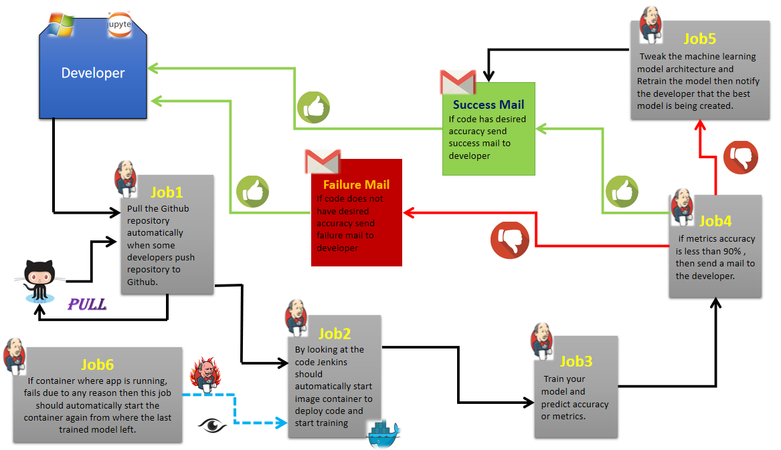
Architecture of the Automated Pipeline
12

Slide 16
Github link for code : https://github.com/Sanidhya-Sinha/MLopsproject.git
13

Slide 17
PROCESS OF AUTOMATION

Slide 18
Before job1 :
14
First we will create a container image that has python3.6 installed (in addition to all the other libraries which will be necessary for a ML/DL code to run) using Dockerfile.
Go inside any folder and create Dockerfile
# mkdir mlops
# cd mlops
# gedit Dockerfile

Slide 19
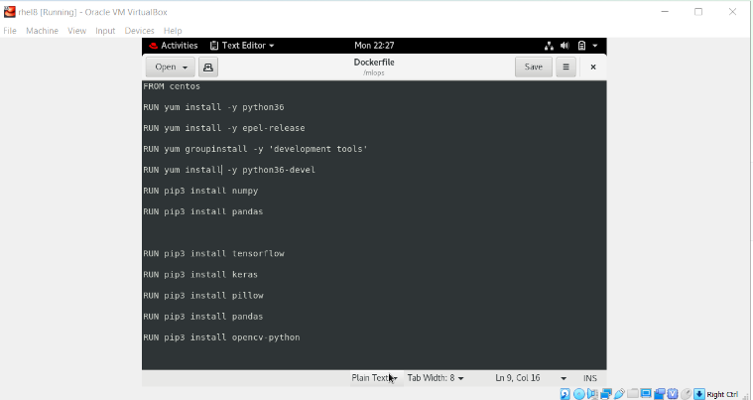
Before job1 :
15
Inside the Dockerfile
Save it and after that build the image using
# docker build -t mlops_setup:v3 /mlops/

Slide 20
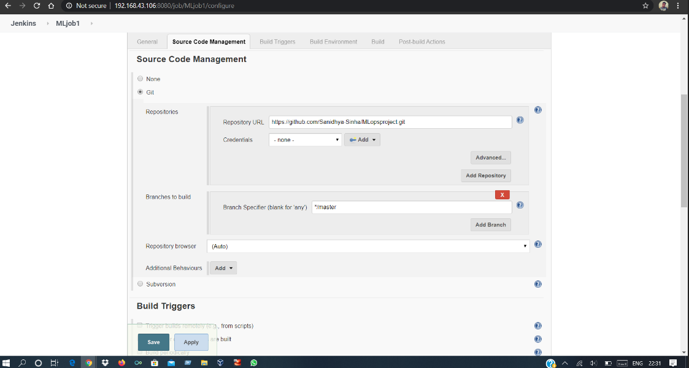
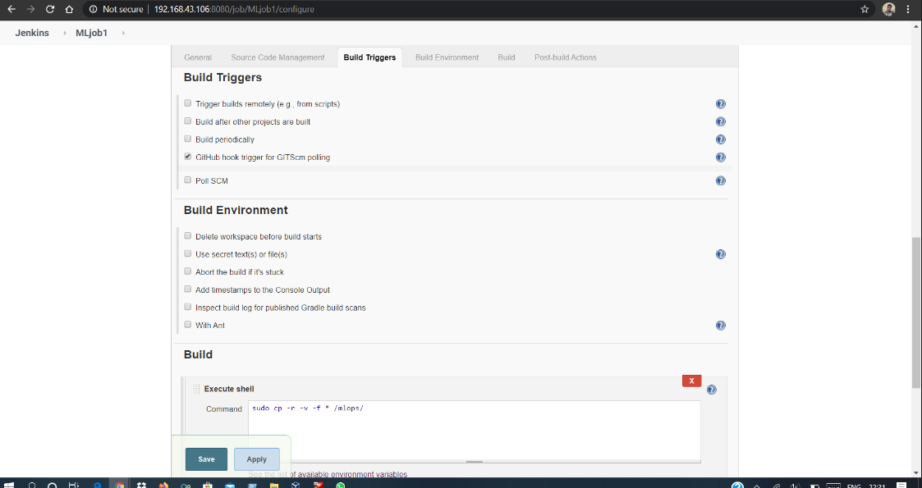
JOB 1 :
16
Here it will pull the github repository automatically when the developer push the code in the github repo.

Slide 21
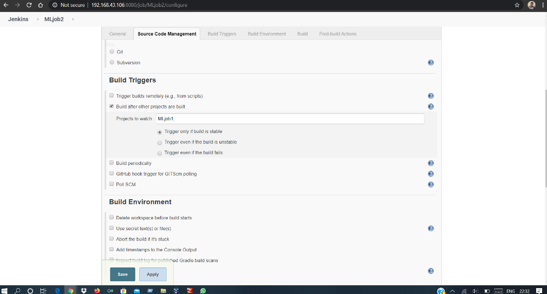
JOB 2 :
17
By looking at the code or program file , Jenkins should automatically start the respective machine learning software installed interpreter install image container to deploy code and start training( eg. If code uses CNN, then Jenkins should start the container that has already installed all the software required for the CNN processing).

Slide 22
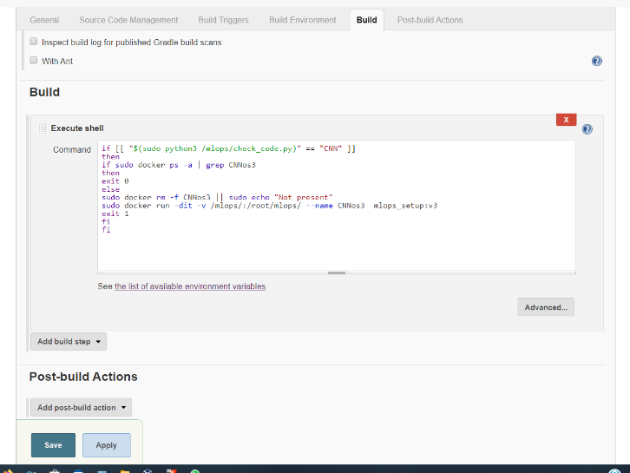
JOB 2 :
18
This job will automatically trigger if Job1 runs accurately otherwise it will not execute.

Slide 23
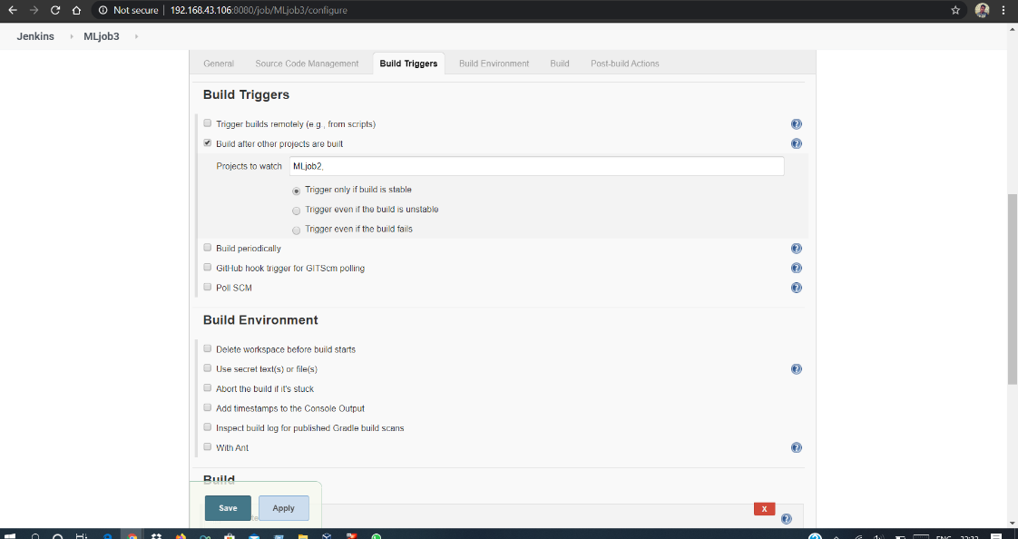
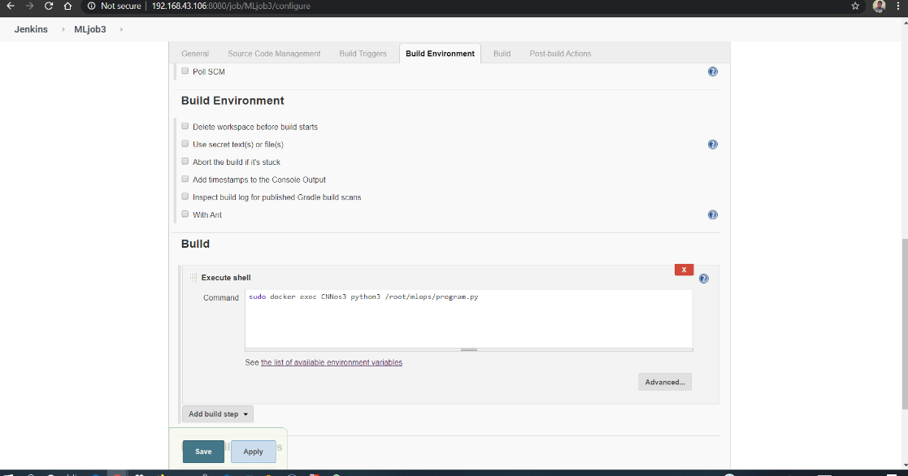
JOB 3:
19
It will train the model and will give the accuracy . It will trigger after Job2 completion

Slide 24
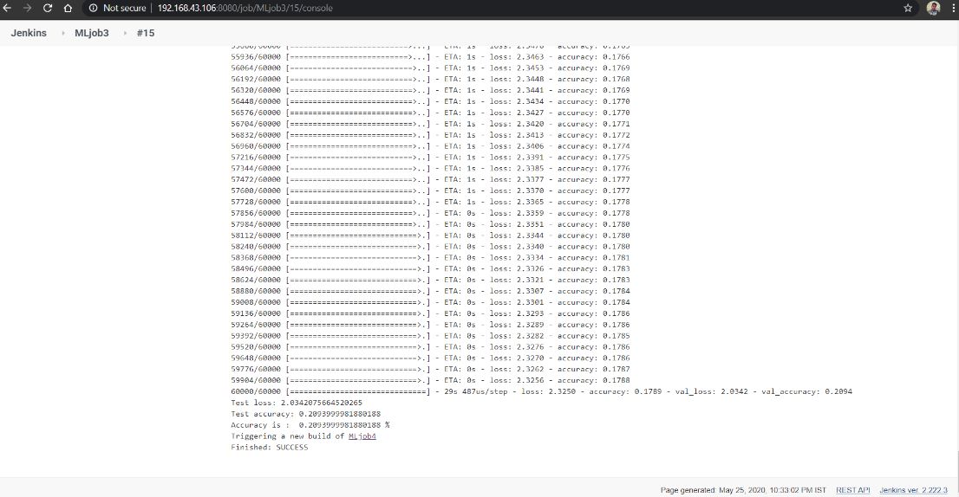
JOB 3:
20
This accuracy we will store in a .txt file so that we can extract it and use in further jobs.

Slide 25
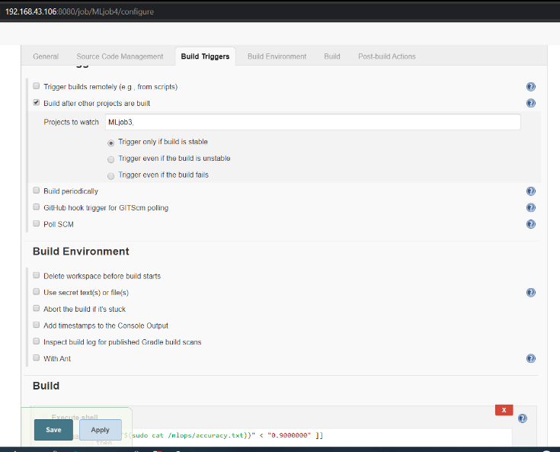
JOB 4:
21
It will check the accuracy if it is above 90% then it will send mail to the developer that the code has the accuracy more than the desired .
But if it has less accuracy then it will send mail to the developer that the accuracy doesn't match with the required. And then it will trigger Job5 for tweaking

Slide 26
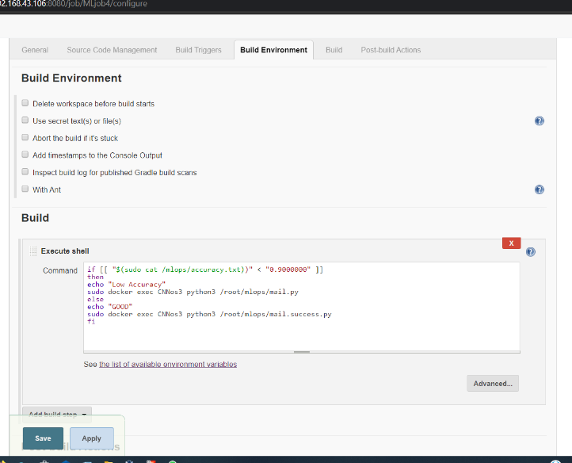
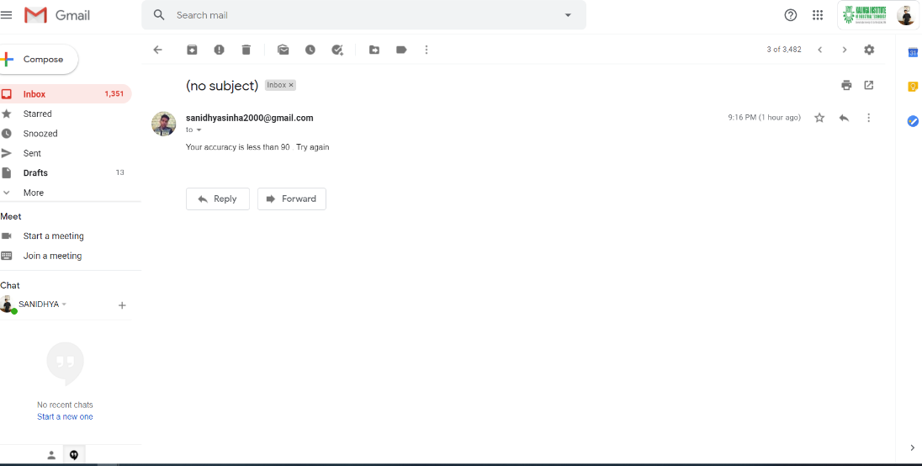
JOB 4:
22
It will send the mail because of low accuracy of the model . This job will run after the completion of Job3.

Slide 27
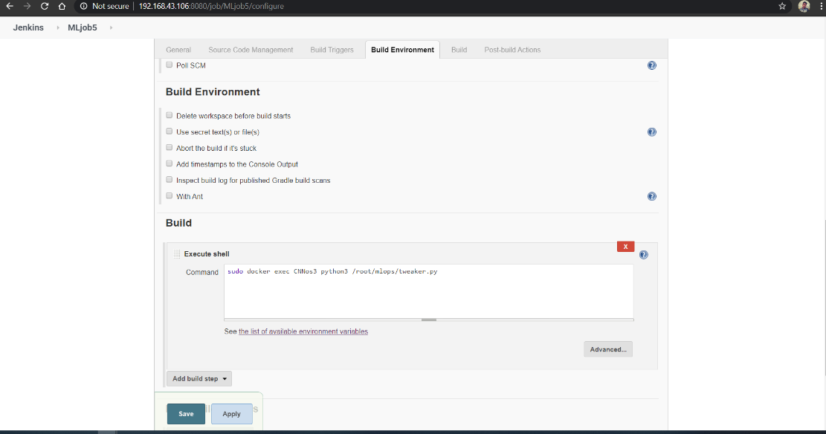
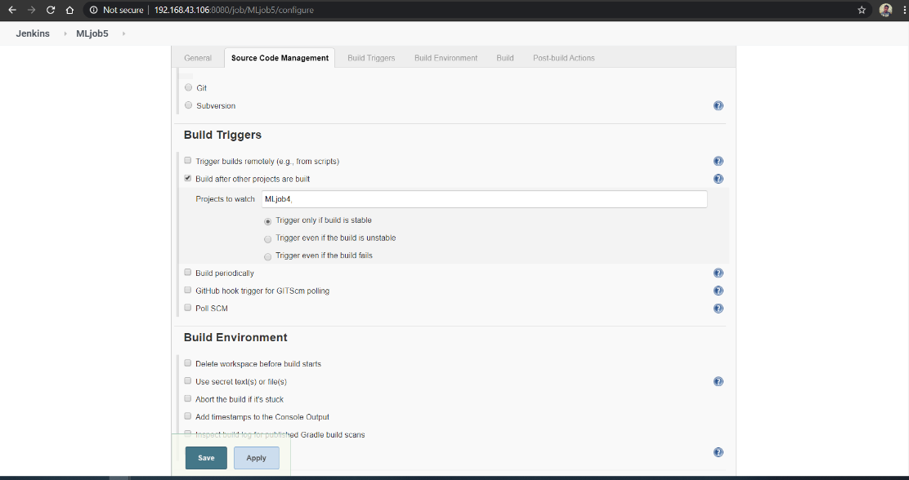
JOB 5:
23
It will tweak the model and will make changes in the code in order to achieve the required accuracy.Here we will extract the accuracy number from that .txt file and will pass through the tweaker.py code.

Slide 28
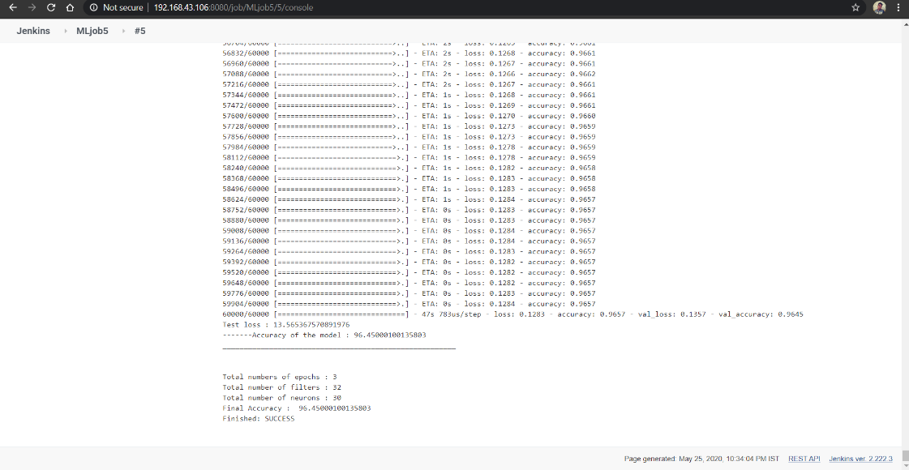
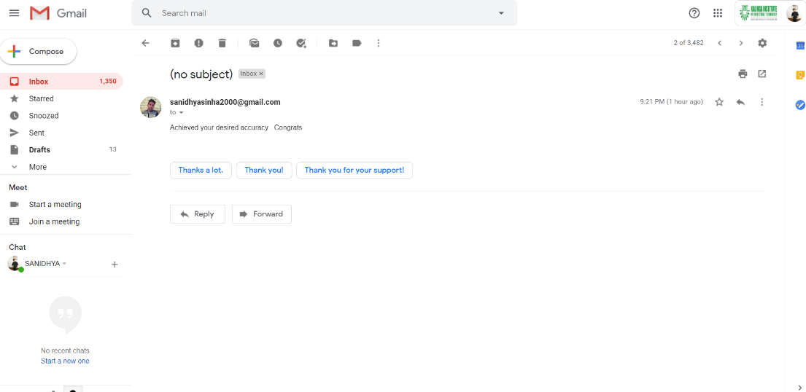
JOB 5:
24
This job will push the mail when the accuracy will be achieved.

Slide 29
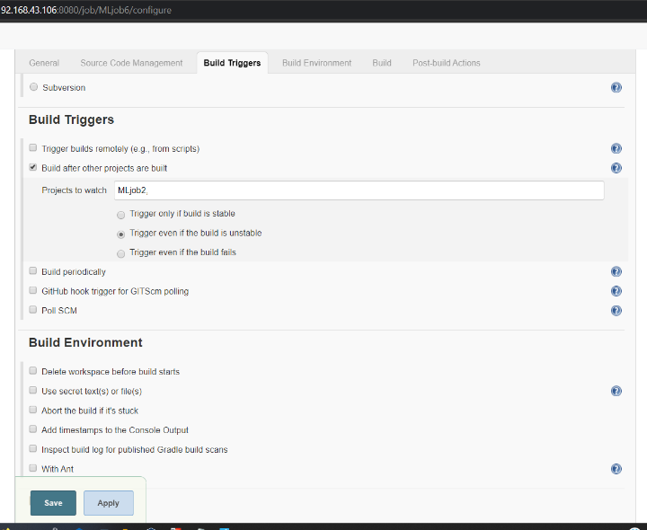
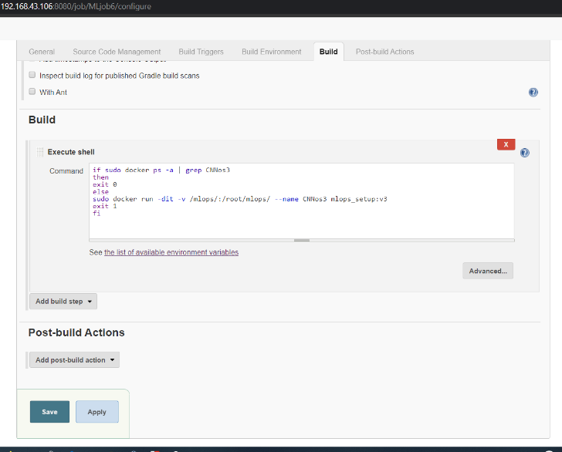
JOB 6:
25
If the container where the code is running fails due to any reason then this job will automatically start the container again. It will trigger when job2 is unstable

Slide 30
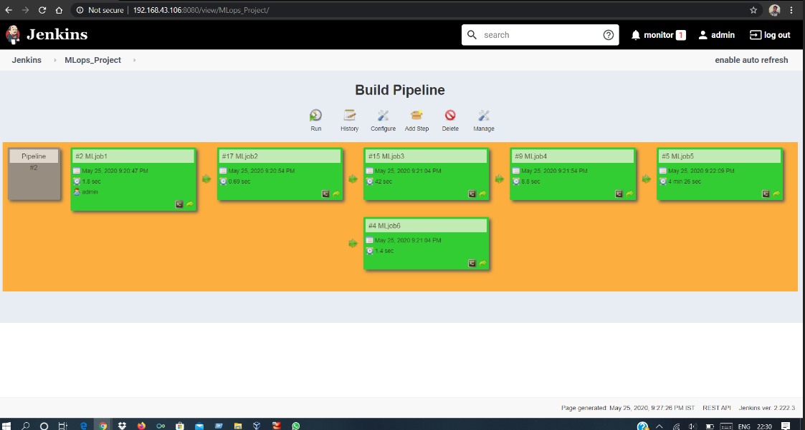
The complete pipeline of this project will look like this :-
26

Slide 31
Conclusion
27
Learned about hyperparameters and how it affects the model.
Overshadowing some main problems of hyperparameters.
Tried to build a prototype , pipeline to automate the CNN code.
It helps the developer w.r.t , time, power, cost.

Slide 32
THANK YOU

